Slide 1
Introduction to AI
CT017-3-1 Ver 1.0
Knowledge Representation 2_ Semantic
https://www.youtube.com/watch?v=9EsumyUT6Fg&list=RDIAF3c_FiWaQ&index=3

Slide 2
Topic & Structure of The Lesson
Semantic network / Semantic net

Slide 3
Learning Outcomes
At the end of this topic, You should be able to
Semantic networks represent dependencies between concepts or topics, and thus are well-suited not only for processing by computers but also for knowledge transfer

Slide 4
Key Terms You Must Be Able To Use
If you have mastered this topic, you should be able to use the following terms correctly in your assignments and exams:
Semantic network
Relationship

Slide 5
Semantic Networks
A collection of nodes and links
Nodes represent concepts
Links (arcs) are directed and labelled
Links represent relations between nodes (concepts)
Semantic network is a directed graph

Slide 6
Question
Fido is a dog, dogs have 4 legs, so Fido has legs
Is_a
isa
Fido
dog
has
Is_a(Fido,Dog) - fact
4 legs

Slide 7
Semantic Nets: student world Links between Concepts Define Meaning
module
award
isa
instance
BSc
isa
instance
instance
MSc
AI
C++
DB
halls
F.Bloggs
student

Slide 8
Semantic Nets: student world
award
module
consist_of
BSc
isa
DB
instance
isa
instance
C++
AI
MSc
enrolled
halls
F.Bloggs
student
resides
instance

Slide 9
Can SN cope with exceptions?
isa
animal
bird
wings
has_part
can
isa
fly
isa
can
penguin?
sing
What can we say
about penguin?
canary
size
small
instance
colour
yellow
tweety

Slide 10
Evaluation of SN
Advantages
easy to understand, good at describing declarative knowledge
Key feature: inheritance
economy of effort: inference achieved through links
reduce search time (nodes are connected to related nodes)
flexibility in adding new nodes
closer to human information storage

Slide 11
Evaluation of SN
Limitations
no standard representation
exceptions are difficult to handle (inherit all features)
sequence and time difficult to capture
difficult to represent procedural knowledge, negation,

Slide 12
Semantic networks: bird classification
bird
wings
animal
yellow
fly
tweety
sing
canary
small
A set of concepts

Slide 13
Semantic networks: bird classification
isa
animal
has_part
bird
wings
can
can
fly
isa
sing
canary
size
small
Bird has wings,
and can fly and
can sing
colour
instance
yellow
tweety

Slide 14
Quick Review Question
Represent the following to semantic net
Tom is a cat.
Tom caught a bird.
Tom is owned by John.
Tom is ginger in colour.
Cats like cream.
The cat sat on the mat.
A cat is a mammal.
A bird is an animal.
All mammals are animals.
Mammals have fur.
Isa
tom
cat
Caught_a
bird

Slide 15
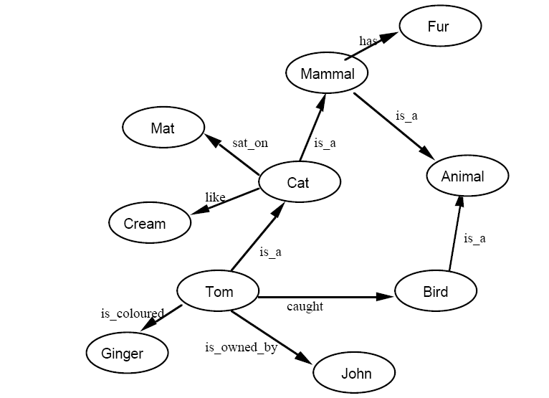
Tutorial(answer) - Semantic

Slide 16
Tutorial(answer) - Semantic
A direct Prolog representation can be used, with classes represented by
predicates, thus:
cat(tom).
cat(cat1).
mat(mat1).
sat_on(cat1,mat1).
bird(bird1).
caught(tom,bird1).
like(X,cream) :– cat(X).
mammal(X) :– cat(X).
has(X,fur) :– mammal(X).
animal(X) :– mammal(X).
animal(X) :– bird(X).
owns(john,tom).
is_coloured(tom,ginger).

Slide 17
Summary of Main Teaching Points
Using Semantic Networks for representing knowledge has particular advantages:
structure the knowledge
a hierarchy of default values
powerful representational possibilities as a result of “is a” and “is a part of” inheritance hierarchies.
Semantic network is extremely general, and that can actually be a disadvantage.
For it to be a useful tool, it must be much refined, and a clear syntax and semantics need to be worked out.

Slide 18
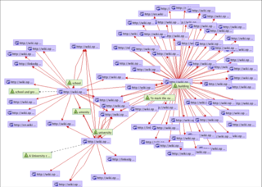
Semantic network – in the world
Web 1.0 ? – html – 1 way communication
Web 2.0? – social media
Web 3.0

Slide 19
Question and Answer Session
Q & A

Slide 20
What we will cover next
Uninformed Search

